Slide 1
Non-Life Insurance in India: Landscape and Opportunity
January, 2016
Shrirang V Samant
Country Head & Chief Representative – India
Travelers Insurance Companies
DISCLAIMER: The opinions and views expressed in this presentation are those of the author and do not necessarily reflect the position of Travelers Insurance Companies

Slide 2
Executive Summary
India socio-economic overview
  Country has geographical, social and economic diversity
  Registered strong growth during the last 10-15 years due to economic policy reforms
  A comparatively younger population and a growing consuming class are key economy drivers
  Projected to grow significantly over the next few years due to inherent socio-economic strengths
Non-life Insurance Industry Overview
  Industry has evolved significantly since liberalisation in Year 2000 to grow approximately 8x
  Growth to continue due to growing economy and increasing insurance penetration
  Competitive market consisting of Government owned insurance companies and JVs of global insurance companies
  Favourable industry outlook with opportunities for generating significant ROEs overtime
Can you afford to wait and watch?
  Assured Growth
  Attractive returns
  Attractive future profitability

Slide 3
Country Overview

Slide 4
India – Macro-economic Overview
India is a geographical diverse multi-cultural, multi-lingual and multi-religious country
General Profile
1
Macro Economic Indicators
2
World’s 7th largest country by area - 3,166,000 square kilometers
World’s 2nd largest population- 1,252 Mn (2013 est)
Nominal GDP - USD 2,180 Bn (December 2015)
Global Investment destination: Attracted USD 44.9 Bn as FDI in FY15
Sectoral share in GDP (FY15) Agriculture –18%, Industry – 24%, Services – 58%
◦New Delhi Political Capital
◦ Kolkata Commercial, Old economy businesses
◦Mumbai Commercial Capital
Political System
3
Major Cities
Largest democracy in the world
Stable single party majority
Economic reforms and liberalization have become politically neutral and usually irreversible
Bengaluru ◦
◦Chennai
IT, Automobiles
IT
After years of licensing and control, India started its major economic reforms from 1992
FY ’15 corresponds to the period from 1st April 2014 to 31st March 2015
Source: Census Database, Industry Reports, EIU, 1 USD = 60 INR; KPMG Analysis

Slide 5
India – Macro-economic Overview
India has demonstrated strong economic growth and has greater potential for future growth vis-à-vis many other world economies…
India has showcased robust growth over the decades
A steady growth over the decade despite the recent relative slowdown
GDP Growth
Global Recession
Slow
Down
India is expected to be amongst the top growing economies in the near future…
8.84%
6.69%
1.23%
2.51%
CAGR ‘08-13
6.64%
6.38%
2.61%
2.98%
1.09%
3.56%
-0.10%
1.87%
CAGR ‘13-18
1.91%
4.20%
Note : CAGR for Real GDP in Local Currency Unit
Source: CSO., Economist Intelligence Unit Data; KPMG Analysis

Slide 6
India – Macro-economic Overview
India’s long-term outlook is bright due to inherent strengths that characterize the economy
Growing working age population…
… driven by high domestic demand …
Domestic Demand as % of GDP (FY 13)
*Domestic Demand = consumer demand + government spends + investments + imports - exports
… and a burgeoning consumer and urban class..
.. implies potential for high growth In GDP
GDP Growth (CAGR 2018)
Urbanization %
2011 | 2030 (F)
31% | 40%
CY
CY
CY
Note: Categories based on annual household income in INR
Elite (> USD 16.66K,; Consuming (USD 1.50k-16.66k) and Deprived (< USD 1.50k),
Source: IMF, UN Population Statistics, EIU, Census Data, KPMG Analysis 1 USD = INR 60
6

Slide 7
Non-life Insurance Industry

Slide 8
Non-Life Insurance Industry Overview
Significant evolution since entry of foreign and private insurers in 2000
Historical developments in the regulatory environment
Future
Insurance Act, 1938.
Insurance nationalization
IRDA Bill cleared
Entry by private and foreign players
Abolition of third party motor pool
1972
1938
1950
1994
1999
2000
2001
2003
2007
2014
2017
Tariff Advisory Comm.
Price Detariffication*
Number of players
107
1 (with 4 subsidiaries)
19
28
30-32
Projected growth at 17%
growth at 17% (mainly penetration driven)
Detariff. Impact - growth at15%
Market Growth and Size#
Growth mainly Inflation led
12%
± USD 29 Mn
± USD 1.6 Bn
± USD 4.2 Bn
± USD 12.92 Bn
*Insurance companies are free to determine the premium rates of products (except commercial vehicle third party damage)
Source : IRDA

Slide 9
Non-Life Insurance Industry Overview
Economic growth and improving penetration will drive market @16%-18% CAGR to create a USD 45 Bn+ industry in 10 years time
Non-life Insurance Penetration and Density in India (2013)
Gross Direct Premium (USD billion)
Source: Insurance Regulatory Development Authority (IRDA)
Current density and penetration of non-life insurance (including Accident &Health (A&H) insurance) in India is amongst the lowest in the wolrd– In FY 13 non-life density was USD 11, ranked 85 in the world, while penetration (Premium as a % of GDP) was a mere 0.8%
Driven predominantly by the motor and indemnity-based A&H insurance business, the Indian non-life insurance industry has grown steadily over the past few years and was estimated at USD 12.9 billion at the end of FY14, growing at a CAGR of 18% since FY11
Significant premium accretion with market growing to USD 45 Bn from USD 13 Bn would create scope for new entrants
9

Slide 10
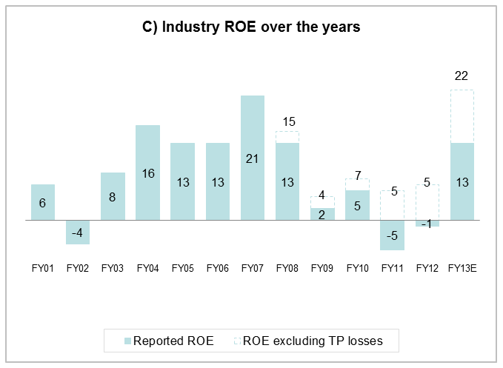
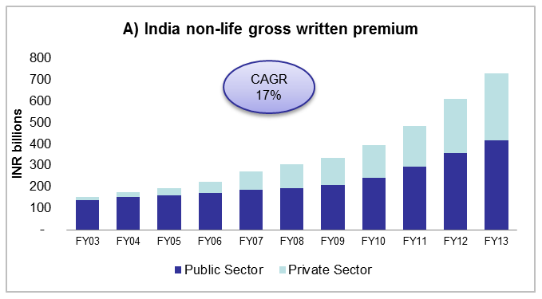
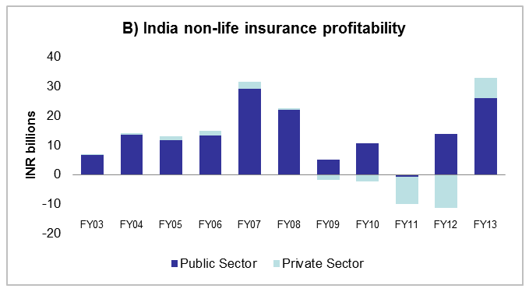
Non-Life Insurance Industry Overview
Market Size, Profitability and ROE
Source: IRDA Annual Reports
Source: IRDA Annual Reports
Premiums continue to grow and profitability is improving
All lines except third-party auto have been de-tariffed
  In third-party auto, rate increase need recognised by regulator and ~40% increase made during last 2 years
Growth to continue in excess of economic growth due to low penetration and expected demographic dividend
Many key global players have already entered the market
N. America | AIG, Liberty, Fairfax, CIGNA
Europe | Allianz, AXA, Munich, Generali, RSA (now divested), HDI, BUPA
Asia-pacific | Mitsui, Tokio Marine, Sompo, IAG, QBE
Initial Liberalisation Detarification Partial Recovery
Source: FICCI-Mckinsey GI Industry vision report

Slide 11
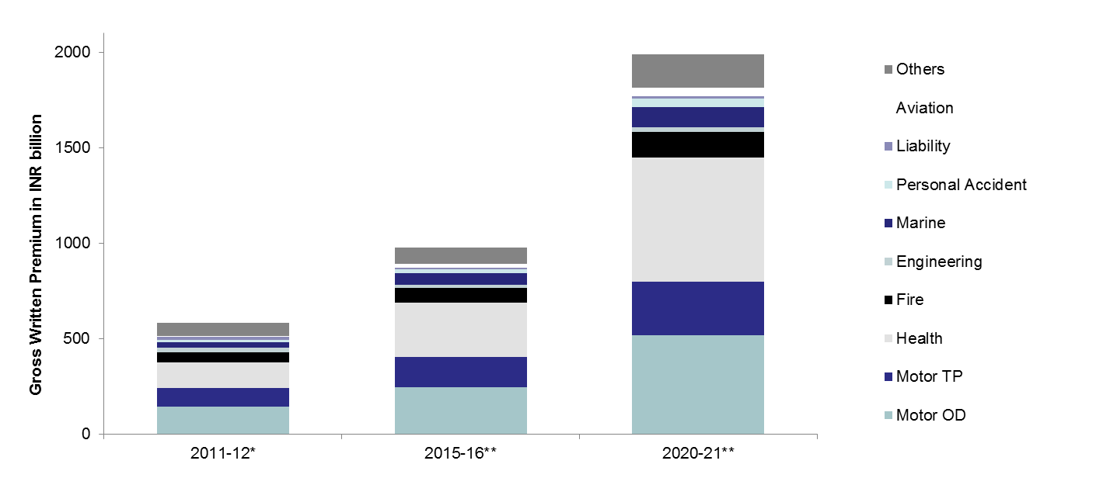
Non-Life Insurance Industry Overview
Growth Trends over years by Line of Business
INR 2004 bn
USD 33.4 bn
INR 986 bn
USD 16.4 bn
INR 583 bn
USD 9.7 bn
Market size projected by estimating LOB wise growth in line with recent trends duly adjusted for some foreseeable market factors such as growing customer awareness; Increased penetration; Regulatory Initiatives; Pricing corrections in some lines
Unforeseen disruptive events such as regulatory actions , additional govt. initiatives for health and agriculture etc. not taken into account
Double digit growth in all lines of business resulting in significant GWP accretion over time
Source: *IRDA segment-wise figures March 2012
** Average of Market Estimates
Note: Fiscal year runs from 4/1 to 3/31.
Exchange rate: 60 INR = 1 USD

Slide 12
Non-Life Insurance Industry Overview
Motor Insurance is the single largest line of business in the market
Product Segments | Key Products | Target Segments | Segment Size and Market Share (FY14)
Motor | Own Damage (OD) Third Party Damage (TP) – Mandatory Comprehensive (Package of OD & TP) | Private Car owners Commercial Vehicles owners Two-wheeler owners | USD 5.65 Bn (44%)
Accident & Health | Mediclaim (Indemnity based product to cover treatment costs) Critical illness (fixed benefit product) Hospital Cash (fixed benefit product) Personal Accident (fixed Benefit based product), Travel insurance | Individual / Family (Retail) Group (Corporate) Government | USD 3.24 Bn (25%)
Fire | Fire and Special Perils Consequential Loss Industrial All risks | Small and Medium scale enterprise Large corporate | USD 1.23 Bn (10%)
Engineering | Boiler and Pressure plants insurance Electronic Equipment Machinery Break-down (profit loss) Erection/ Construction all risks |  | USD 0.41 Bn (3%)
Marine | Marine Cargo Marine Hull |  | USD 0.53 Bn (4%)
Miscellaneous | Home (Structure and contents) | Individuals | USD 1.87 Bn (14%)
 | Cattle, weather, tractor | Rural
 | Public liability (industrial & non-industrial), product liability, workmen’s compensation, professional indemnity | Professionals SME, corporate
 | Aviation, other customized products | SME, Large corporate
Source: IRDA Annual Reports

Slide 13
Non-Life Insurance Industry Overview
Existence of multiple distribution channels: Auto dealers strong in motor; Brokers strong in commercial; New trend towards DTC for personal Iines
Agents (OnlyTied)
Small tied agents operating locally in retail markets (individual agents).
Companies (mid to large) with a tied agency license (corporate agencies).
Auto Dealers
Automobile dealerships operating as agents for insurance of vehicles sold though them (primarily new vehicles).
Brokers
Large and small organisations primarily active in Commercial segment. Have significant say in insurance purchase decisions.
Own Sales
(Field Force)
Active in managing corporate accounts and developing business either directly or through involvement of brokers.
Own Sales
(Direct-Online)
Small but growing segment. Will become important as the young internet user starts acquiring more and more assets.
Bancassurance
Significant play in Home Insurance through tie up with Home finance. Some involvement in Motor Insurance due to Car finance.
Source: Boston Consulting Group - Indian General Insurance Market, May 2011

Slide 14
Political, Social and Demographic Scenario

Slide 15
Country Context
India overview
Investment environment in India has significantly improved with recent political and policy changes.
Compelling demographic trends remain with fast progression towards a highly digital future.
Specific to insurance, the Foreign Direct Investment limit has been increased from 26% to 49%
India’s consumer base is rapidly moving towards a highly digitized experience

Slide 16
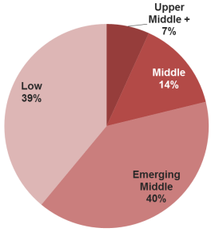
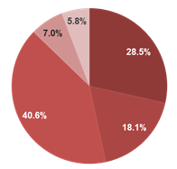
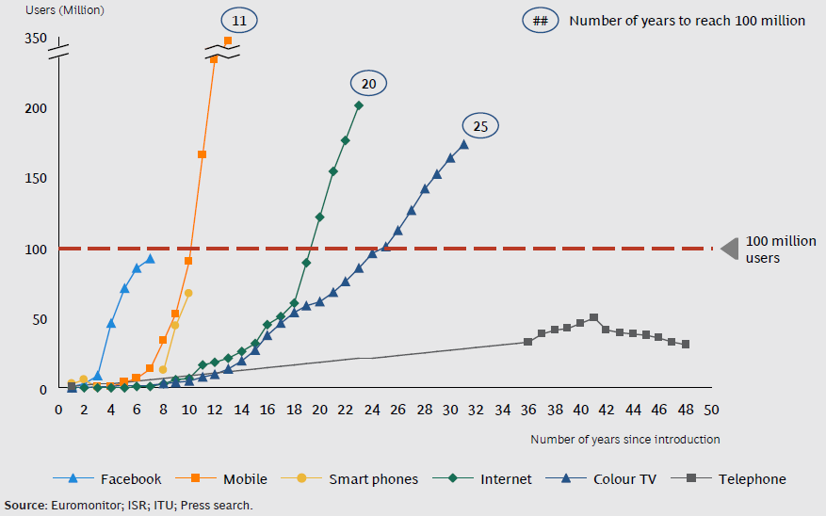
Country Context
Why does India make sense as a target country?
India Demographics
Large, fast growing economy
Favorable demographics
Rapid digital transformation
Stable polity with a clear direction
Global / Macro-economic Context: 6th Largest economy in the world. $2T GDP growing at 7.5%.
Social Change: World’s largest youth population with majority of 1.2b people under 25 with an increasingly urbanized, growing middle class with higher disposable income and discretionary spending.
Political Change: Series of initiatives launched for job creation, digital proliferation, urbanization, public health, and personal finance, to help move India forward.
Digital Trends: While still in a period of emergence, Internet and mobile connectivity is exploding. Major government emphasis on digital enablement.
Age Distribution
Income Distribution
Internet Adoption
Source: Various Publications: India at a glance

Slide 17
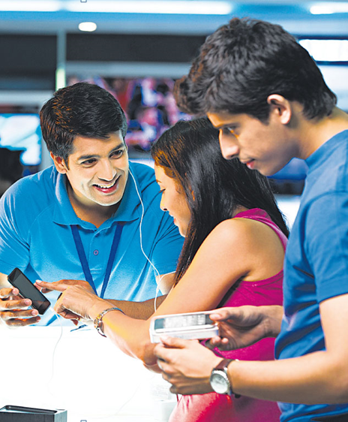
Country Context
How is technology in India changing consumer behavior?
Nine Pillars of Digital India
Technological transformation in the country is changing buyer behavior
Going Mobile
Focus on Infrastructure to Every Citizen, Services on Demand & Digital Empowerment of Citizen
Deals in the on-line retail space (Flipkart, Snapdeal) accounted for 75% of venture capital inflows
E-commerce grew at a CAGR of nearly 35% form 2009 to 2013. Industry could reach $20B USD in 2020
31% of consumers research insurance on-line while only 11% purchase pointing to concerns with current online experience
Smartphone users are expected to grow from 90 million in 2013 to 520 million in 2020 - mobile is the most popular way of accessing Internet in India, increasing Internet penetration.
Sources: Country Context, BCG: Insurance @ Digital

Slide 18
The Opportunity Beckons

Slide 19
Non-Life Insurance Industry Overview
Industry Performance and Market Outlook
Performance
Outlook
  Market grew 8x while delivering profits for 12 out of last 14 years
  Industry grew significantly even in phases of lower economic growth
    Companies with 26% FDI delivered comparatively superior financial performance
    Market saw phases of intense price competition
    Creation of Motor TP pool adversely impacted financials for a few years
    Private companies > 7 years in business achieved ROEs in high teens to over 20%
    Companies with critical mass achieved mid-teens ROE despite underwriting losses due to high investment returns on account of:
  Higher interest rate - Treasury bill @ 6 - 9%
    Higher investible float due to ‘cash and carry’
    Private Companies at 13% ROE in 2013
  Growth momentum to continue with performance improvements
  New government may boost economy further, driving even higher growth for industry
  FDI increase, although beneficial, may cause disruptive events in the medium to short term
  A phase of price competition may re-emerge
  Minimal impact due to TP pool rationalisation and ongoing annual TP rate revision
  Established JVs of Allianz, AIG, RSA, Ergo likely to turn underwriting positive soon
  Investment income would continue to be an important contributor to overall financial results
  Rapid growth of DTC market with significant digital sales / influence

Slide 20
Non-Life Insurance Industry Overview
Existence of multiple distribution channels: Auto dealers strong in motor; Brokers strong in commercial; New trend towards DTC for personal Iines
Non-Life industry Competitive Structure (FY13)
A few new entrants managing profitable growth
Mostly Wave-2 players with high growth low profitability
75%
Apollo Munich
(103)
65%
Bharti Axa (211)
55%
Shriram (261)
Cholamandalam
(275)
45%
CAGR (FY 10 – FY 13)
Mostly Wave-1 players, pursuing profitable growth
HDFC ERGO
Future Generali
(418)
(192)
35%
Mostly Public sector players, lagging on growth as well as profitability
Tata AIG (369)
National (1592)
25%
ICICI Lombard
(1068)
United (1610)
15%
Bajaj Allianz
RSA (265)
IFFCO Tokio
New India (2160)
4,000
(667)
(442)
5%
Oriental (1190)
-
Star Health (143)
5%
95%
100%
105%
110%
115%
120%
125%
130%
Notes:
Size of the bubble indicates Gross Direct Premium in USD Mn
L&T, Magma HDI, Liberty Videocon, Religare have started the business only recently and not shown; Raheja QBE, SBI General, Max BUPA not shown due to their limited scale
Combined Ratio (FY 13)
Source: IRDA, KPMG Analysis
20

Slide 21
Insurance Company Valuations in India
Stake acquirer | Target | Date | % stake | Deal size US $ MN | Valuation US $ MN | Price / Book | Price / Earnings | GWP US $ MN | Remarks
General
Mitsui Sumitomo | Chola MS | Dec-15 | 14% | 136 | 970 | 8.8 | 46 | 291
Ergo | HDFC Ergo | Dec-15 | 23% | 173 | 754 | 4.8 | 47 | 490 | Est. 15x Forward earnigs
Faifax Holdings | ICICI Lombard | Oct-15 | 9% | 239 | 2,650 | 5.4 | 25 | 1,027
AXA | Bharti AXA General | May-15 | 23% | 66 | 289 | 1.3 | NA | 224 | FY 15: USD 18 MN loss
QBE | Raheja QBE | Aug-15 | 23% | 16 | 69 | 2.1 | 42 | 3
Sunadaram Finance | Royal Sundaram | Aug-14 | 26% | 72 | 277 | 3.4 | 26 | 221
Ergo | HDFC General | Nov-07 | 26% | 31 | 118 | 6.1 | 385 | 30 | *If constant Dollar @65
Health only
BUPA | Max Bupa | Nov-15 | 23% | 29 | 128 | 1.1 | NA |  | FY 15: USD 9 MN loss
Munich Re | Apollo Munich | Jan-16 | 23% | 24 | 104 | 1.1 | 1126
Life
Sun Life | Birla Sun Life | Dec-15 | 23% | 256 | 1,113 | 3.3 | 88
AIA | Tata AIA Life | Dec-15 |  |  |  |  |  |  | Deal details not disclosed
Premji (4%) / Temasek (2%) | ICICI Pru Life | Nov-15 | 6% | 300 | 5,000 | 6.2 | 21 |  | Reported to be 2.4x EV
Nippon Life | Reliance Life | Nov-15 | 23% | 348 | 1,515 | 2.9 | 73 |  | Reported to be 3x EV
Aviva International | Aviva India Life | Aug-15 | 23% | 85 | 368 | 1.2 | 48
Standard Life | HDFC Life | Aug-15 | 9% | 262 | 2,906 | 7.3 | 24 |  | Reported to be 2.1x EV
AXA | Bharti AXA Life | May-15 | 23% | 132 | 574 | 1.6 | NA |  | FY 15: USD 19 MN loss
Premji | HDFC Life | Dec-14 | 1% | 31 | 3,062 | 9.0 | 27 |  | Reported to be 2.5x EV
Exide Industries | ING Vysa Life | Jan-13 | 50% | 85 | 169 | 0.8 | NA |  | FY 12: USD 5 MN loss
Mitsui Sumitomo | MAX Life | Apr-12 | 26% | 420 | 1,616 | 4.8 | 23 |  | Reported to be 3x EV
Nippon Life | Reliance Life | Mar-11 | 26% | 471 | 1,812 | 3.8 | NA |  | FY 11: USD 20 MN loss
Company figures from Public disclosures of preceding FY. Valuation figures from Media articles indicating deal sizes. Constant USD @ INR 65.
Several other potential stake increase discussions have been reported, but valuation indications have not yet been provided.
Updated 27/01/2016

Slide 22
Thank you!!

